Slide 1
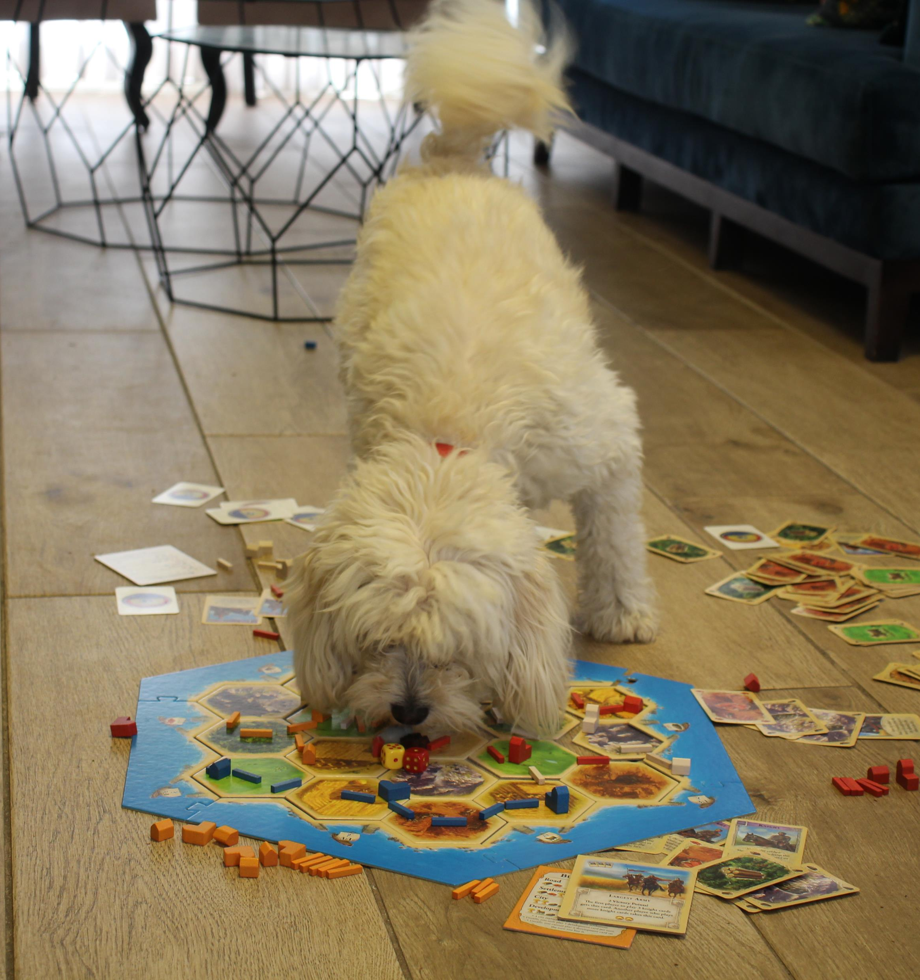
Catan AI Agent AI final project video presentation
By: Roy Suissa Sharon, Boaz Bibi, Oriane Louzoun and Amos Dvir

Slide 2
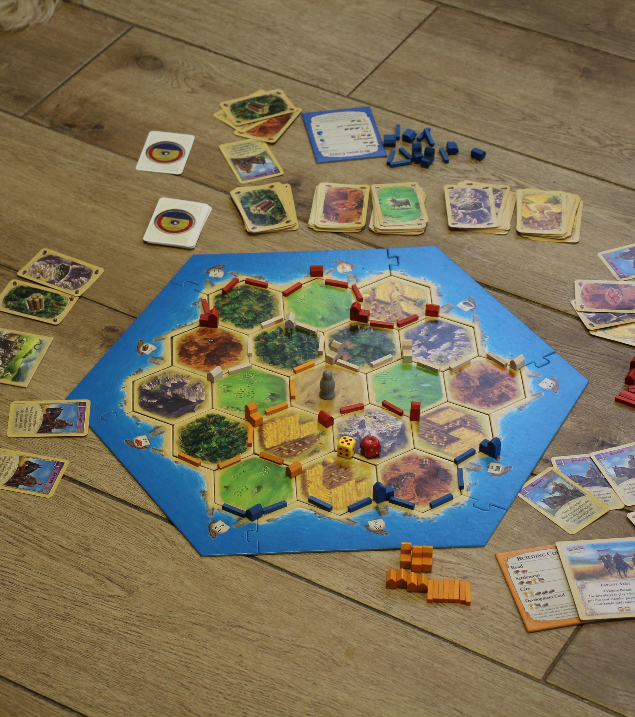
Introduction
Catan is a multiplayer board game
Players in the game are simulating the life of settlers on a remote island called CATAN
Players can build roads, settlements and cities and buy development cards
Each of the object in the game gain some victory points, the players who reaches 10 victory points first wins the game.

Slide 3

Coding background
We used the Hexgrid library that allows to do calculations on a hexagons – which the board is made of
We decided to use the OOP approach and created objects representing the: board, players, agents, dices, and game sessions

Slide 4
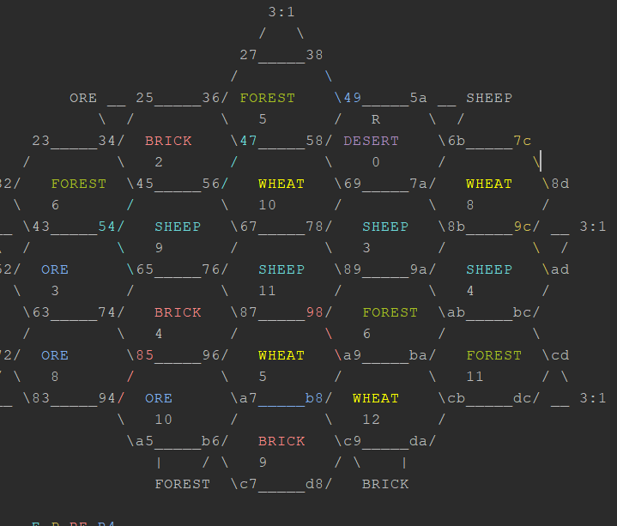
Game session
The game session can be initialized by the code a command line
can given 4 (or less players)
At each point of the game the session can print the state of the game in ASCII form

Slide 5
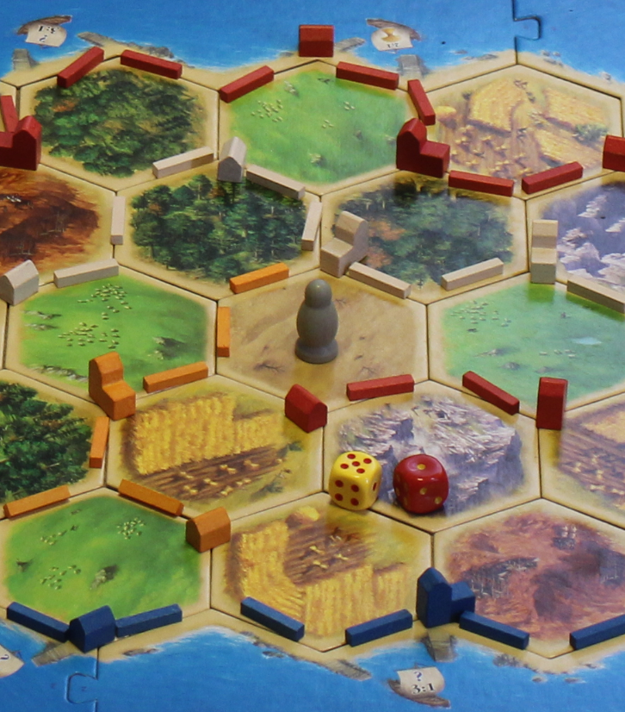
Agents
Each player in the game is given an agent with certain properties.
Agent types:
Human – a player with this agent waits input from a human player at each turn
Random – a player with this agent makes a random move at each turn from a list of legal moves
One Move Heuristic – a player with this agent opens a minimax game tree with a depth of one, and applies the given heuristic to it
Expectimax prob – a player with this agent opens an expectimax game tree to a given depth and applies a given heuristic to it
Probability agent – a player with this agent chooses the move which bring him to the best board in terms of victory points

Slide 6
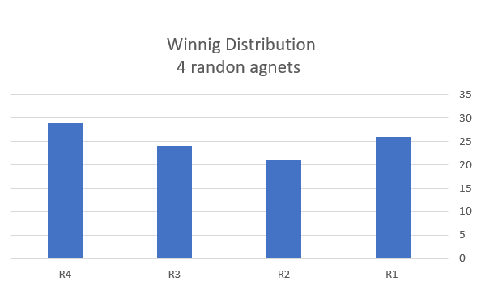
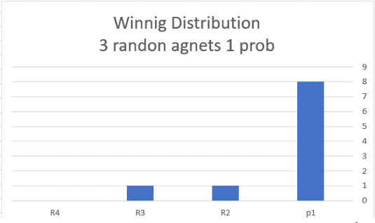
Random agents
We’ve tested the random players against each other to prove the agent are indeed random
Then we tested them against one probability which showed much better results

Slide 7
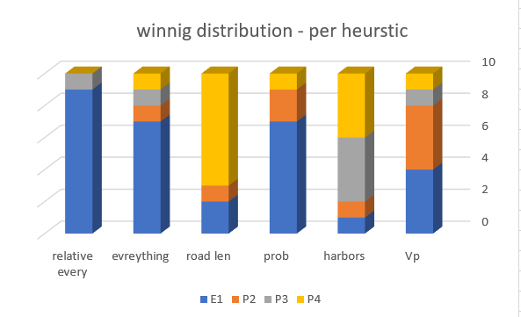
One move Heuristic agent
We have tested against each other and using different and specific heuristics
First, we’ve tested the one move agent with all the heuristics to find the best
The best specific Heuristic was the relative everything heurisitc

Slide 8
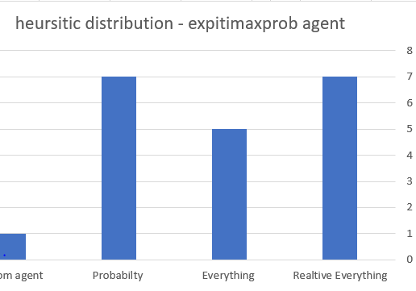
Expectimax Agent
After finding that most of the heuristics were ineffective, we’ve tested the best heuristic on the expectimax prob agent.
The result are like the result of the one move agent.

Slide 9
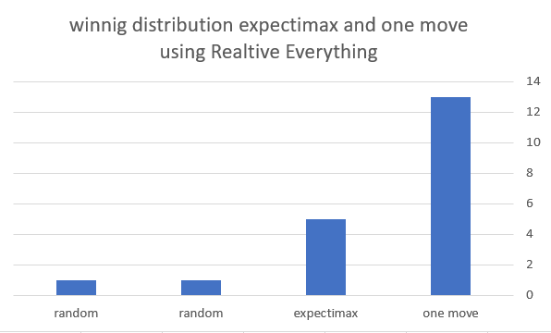
Agents against agents
We’ve tested the one move, expectimax and probability agents against each other, the first two are using the relative everything heuristic

Slide 10
Agents against humans
Since the game is very long, we had trouble testing it against human (we’ve tried enslaving some of our younger siblings to do it ☹)
We’ve tried a couple of games of human against 3 one move heuristic agent using the relative everything heuristic : פה לשים מידע מה קורה

